Slide 1
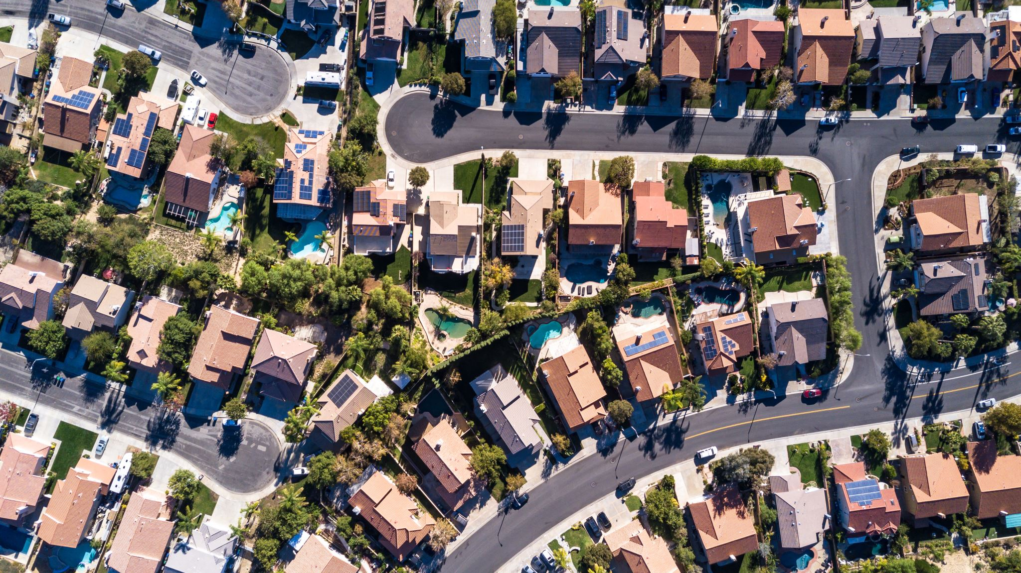
East Coast Real –Estate Machine Leanring Model
Desmond Workman
Jair
Jason
Alexander

Slide 2

Objective
Our primary objective is to build a predictive model that incorporates historical weather data as a feature to predict housing prices. This project aims to uncover insights into how weather conditions impact housing prices in specific areas.

Slide 3
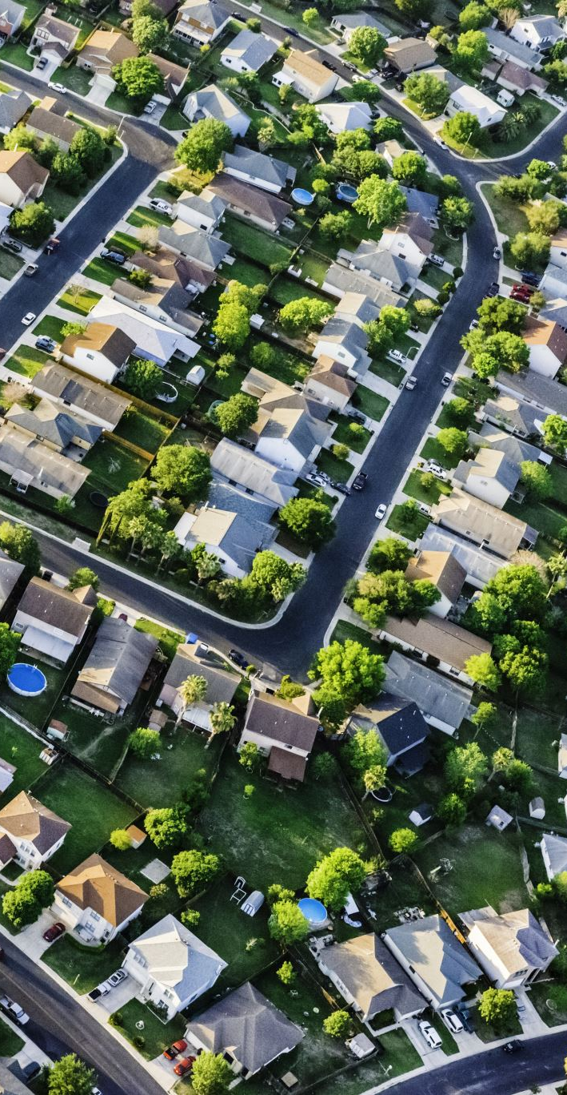
Data Sources
We utilized two main datasets: USA Real Estate Data from Kaggle, and weather data obtained from the OpenWeather API These datasets are crucial for understanding the dynamics between housing prices and weather conditions.

Slide 4
Housing Data Processing

Slide 5
OpenWeather API Data

Slide 6
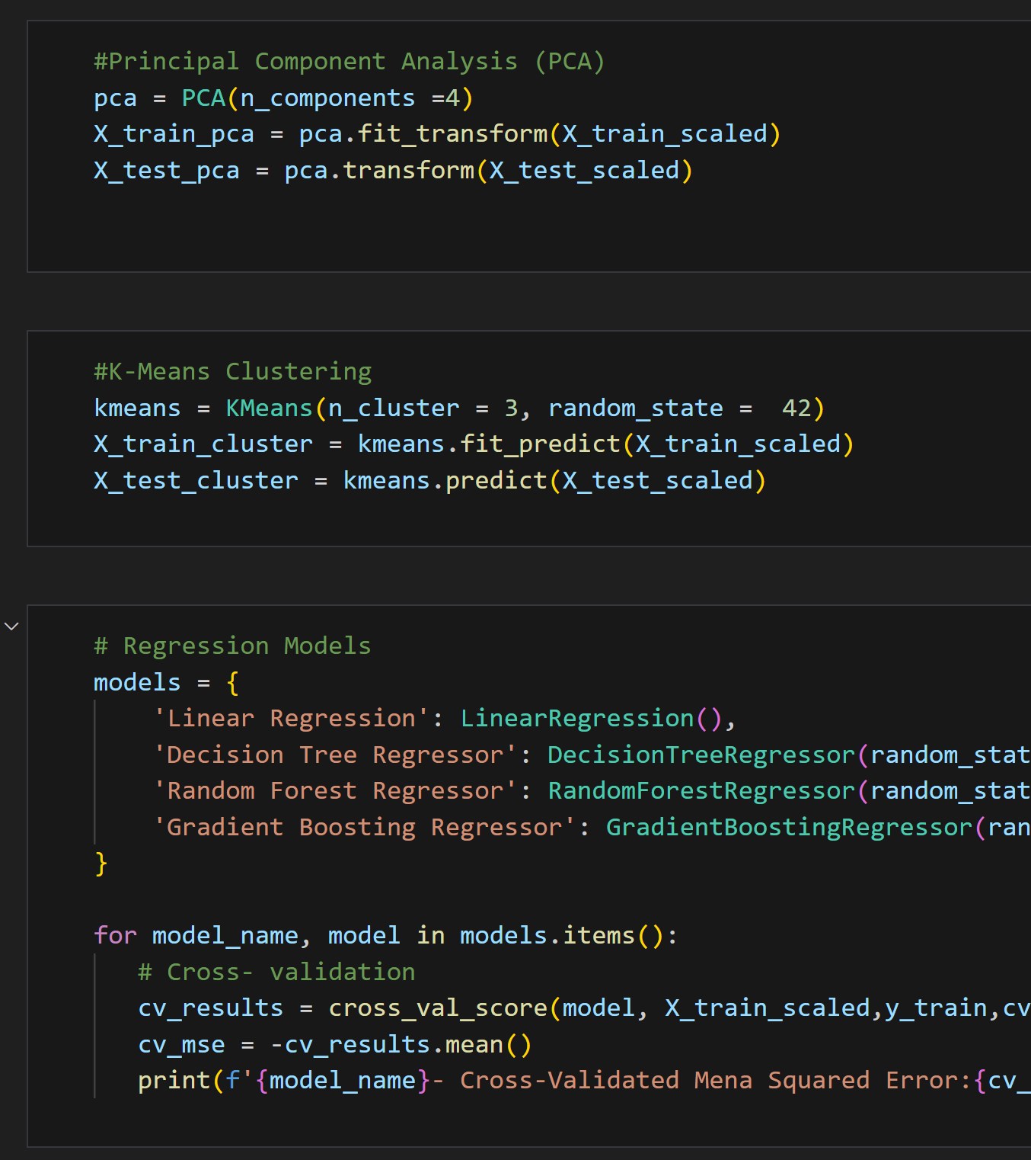
Machine Learning Tasks
Our machine learning tasks include Principal Component Analysis (PCA), clustering, and building a prediction model. PCA helps us identify crucial factors, clustering groups real estate by zip code, and the prediction model forecasts future housing prices.

Slide 7

Regression Models
To test our model, and find the most accurate prediction, we experimented with three different regression models to explore the connection between weather conditions and housing prices.
Here are the models we employed:
Linear Regression:
Assumes linear relationship between independent and dependent variables.
Decision Tree Regressor:
Uses tree like model to make decisions.
Random Forest Regressor:
Generates ensemble of decision trees.
Gradient Boosting Regressor:
Builds multiple weak models sequentially

Slide 8

Cross Validation
To evaluate and compare the models we used k-fold Cross-Validation.
The data is split into (k) subsets or folds
Each model was trained and tested on these subsets to ensure standardization and increase model accuracy
The evaluation metric used was a negative mean-squared error (MSE)

Slide 9

Conclusions, Limitations Q/A

Slide 10

Thank You!

